Slide 1

Azure Pipeine
Abdulrahmn Youssef

Slide 2
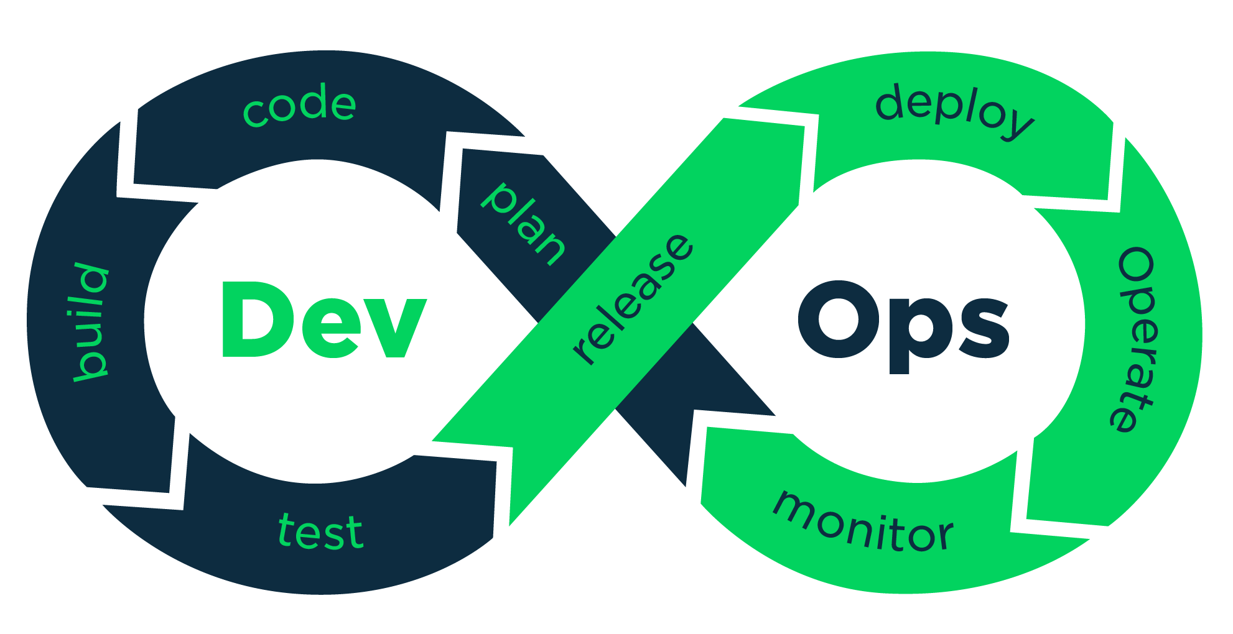
What Is DevOps?
DevOps is a set of practices that combines software development (Dev) and IT operations (Ops). It aims to shorten the systems development life cycle and provide continuous delivery with high software quality. DevOps is complementary with Agile software development; several DevOps aspects came from the Agile methodology.

Slide 3
Why DevOps?
Speed
Rapid Delivery
Reliability
Improved Collaboration

Slide 4
Continuous Integration
Continuous integration automates tests and builds for your project. CI helps to catch bugs or issues early in the development cycle, when they’re easier and faster to fix. Items known as artifacts are produced from CI systems. They're used by the continuous delivery release pipelines to drive automatic deployments

Slide 5
Continuous Delivery
Continuous delivery automatically deploys and tests code in multiple stages to help drive quality. Continuous integration systems produce deployable artifacts, which include infrastructure and apps. Automated release pipelines consume these artifacts to release new versions and fixes to the target of your choice.

Slide 6
Azure Pipeline
Azure Pipelines automatically builds and tests code projects to make them available to others. It works with just about any language or project type. Azure Pipelines combines continuous integration (CI) and continuous delivery (CD) to constantly and consistently test and build your code and ship it to any target.

Slide 7
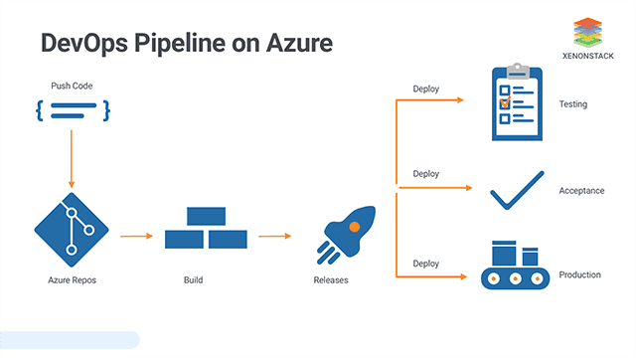
Azure Pipeline

Slide 8
Tasks
A task is the building block for defining automation in a pipeline. A task is simply a packaged script or procedure that has been abstracted with a set of inputs.

Slide 9
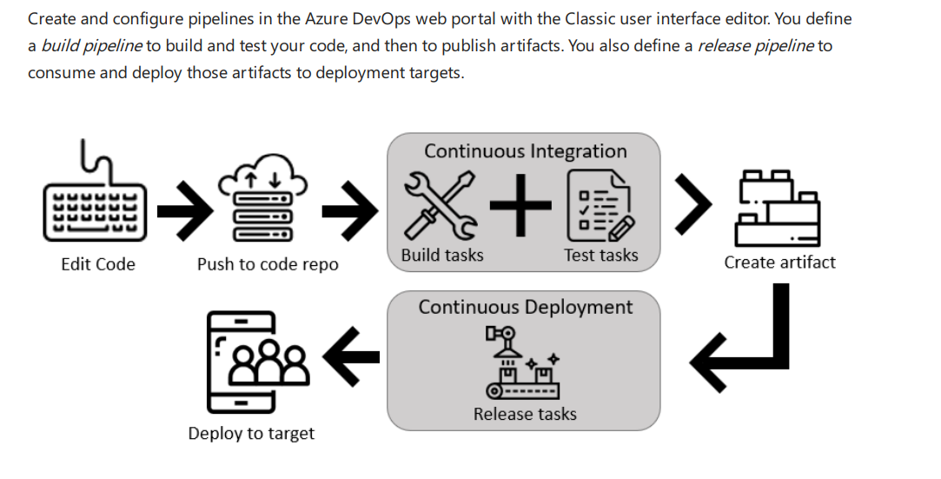
Define pipelines using the Portal

Slide 10
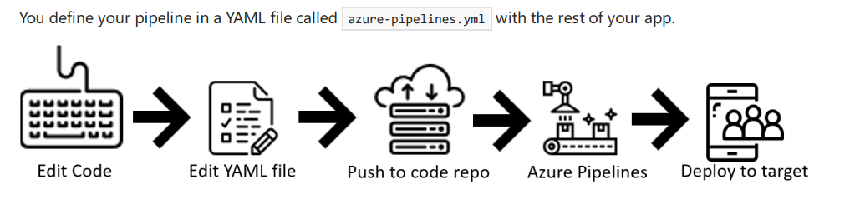
Define pipelines using YAML syntax

Slide 11
Agents
To build your code or deploy your software using Azure Pipelines, you need at least one agent. As you add more code and people, you'll eventually need more.

Slide 12
Self-hosted Agent
An agent that you set up and manage on your own to run jobs is a self-hosted agent. You can use self-hosted agents in Azure Pipelines or Team Foundation Server (TFS). Self-hosted agents give you more control to install dependent software needed for your builds and deployments. Also, machine-level caches and configuration persist from run to run, which can boost speed.
Reference :https://docs.microsoft.com/en-us/azure/devops/pipelines/agents/v2-windows?view=azure-devops

Slide 13
Microsoft-hosted agents
If your pipelines are in Azure Pipelines, then you've got a convenient option to run your jobs using a Microsoft-hosted agent. With Microsoft-hosted agents, maintenance and upgrades are taken care of for you. Each time you run a pipeline, you get a fresh virtual machine.
Refrence : https://docs.microsoft.com/en-us/azure/devops/pipelines/agents/hosted?view=azure-devops&tabs=yaml

Slide 14
Continuous Delivery (CD)
Continuous Delivery (CD) is the process to build, test, configure, and deploy from a build to a production environment. Multiple testing or staging environments create a Release Pipeline to automate the creation of infrastructure and deployment of a new build

Slide 15
Benefits of CD
Automate the Software Release Process
Improve Developer Productivity
Deliver Updates Faster

Slide 16
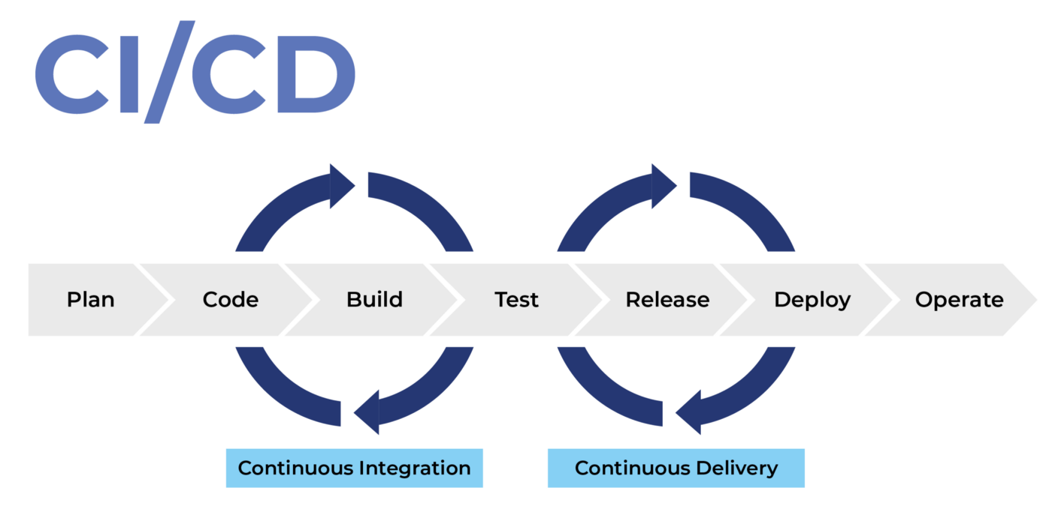
CD

Slide 17
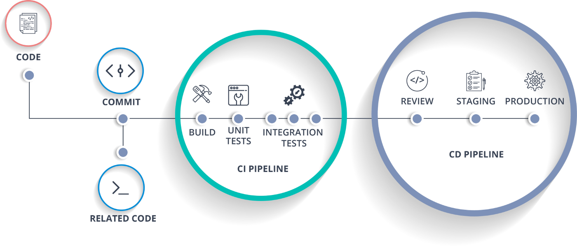
CD

Slide 18
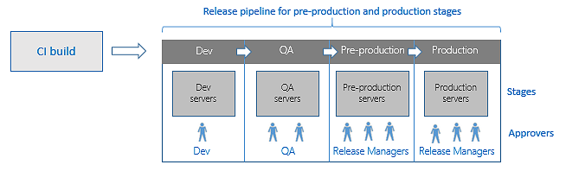
Release pipelines

Slide 19
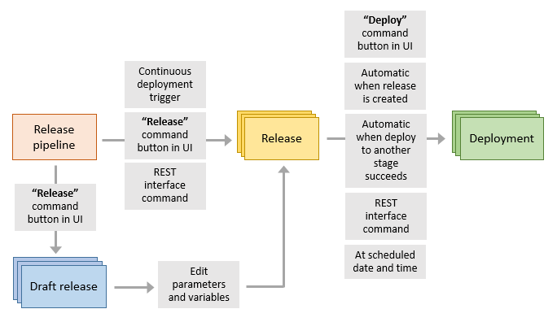
Releases
Infrastructure as Code

Slide 20
Infrastructure as Code
Infrastructure as Code (IaC) is the management of infrastructure (networks, virtual machines, load balancers, and connection topology) in a descriptive model, using the same versioning as DevOps team uses for source code

